Slide 1
Enterprise settings User Guide
2020-06-18
Shenzhen city

Slide 2
Brief Introduction
Enterprise Settings is developed by BCC Mobility.
It was integrated in BCC serial devices.(OS version >= O)
Help customers achieve some common customized needs. These needs can be divided into two parts.
Scan settings
General settings
Provide customers three ways to do these settings:
UI interface
SDK
Broadcast
Notes:SDK and Broadcast way contain all functions. UI interface doesn’t contain all functions.
(For example,”set system time” is only provided by SDK and Broadcast way)
Download Url:
http://ch9ku0001.honeywell.com/svn/mobility/04.Software/05.SoftwareRelease/09.Tools/EzService/
Contact:
Qipeng.Liu@Honeywell.com
If you have good suggestion or other common needs, please let we know, we will consider achieving it and add it to Enterprise Settings.

Slide 3
Enterprise Settings Structure
Enterprise Settings have three parts.
EzService.apk
pkgName:com.honeywell.ezservice
preloaded in OS
Invisible,work in background
Where function real take effect
EnterpriseSettings.apk
pkgName:com.honeywell.ezreceiver
preloaded in OS
integrated honeywellgenerate.aar
Visible,Provide UI interface
honeywellgenerate.aar
The bridge connected to EzService
For 3rd application to integrate
Related document:
Interface document:
Introduce SDK API
Broadcast document:
The broadcast send by EnterpriseSettings after you did some settings
The broadcast 3rd application send to EnterpriseSettings to achieve some needs
Broadcasts’ action and keys

Slide 4
Flow
After device reboot, EzService will be started in background. EnterpriseSettings will bind with EzService.
UI Interface way:
EnterpriseSettings.apk already integrated honeywellgenerate.aar.
UI interface way depends on SDK way.
SDK way:
3rd application should integrate honeywellgenerate.aar.
Then call related api.
Broadcast way:
3rd application doesn’t need integrate honeywellgenerate.aar.
Just send broadcast,Then EnterpriseSettings.apk can receive these broadcast and deal with them by SDK way.

Slide 5

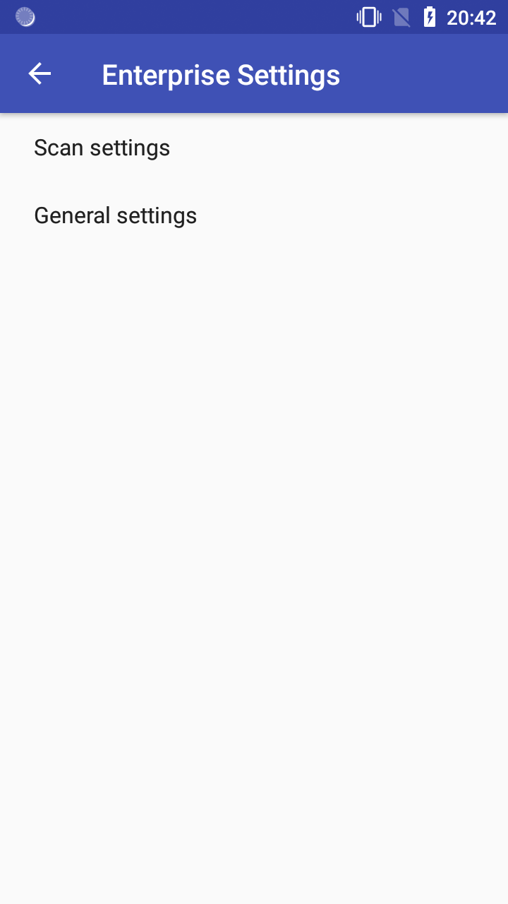
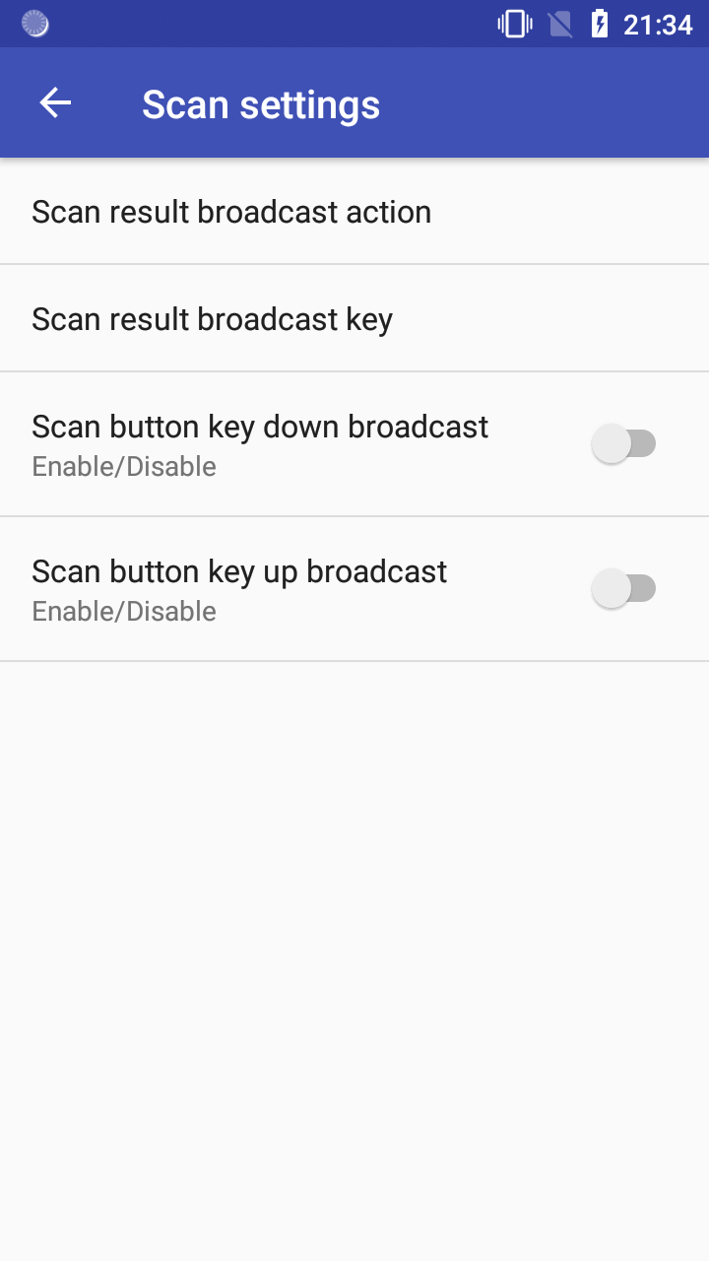
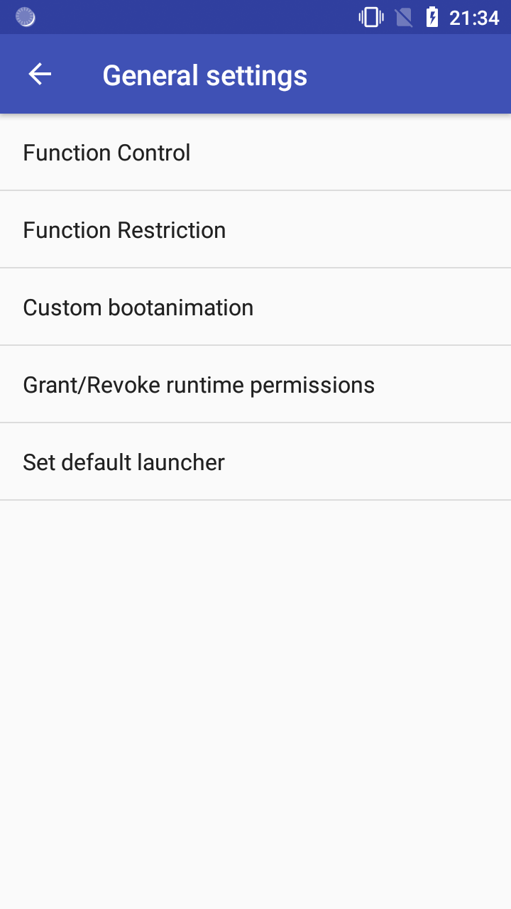
Enterprise Settings UI Interface

Slide 6
Scan settings
Scan result broadcast action/key:
Assume our customers need 1000 devices. At the beginning，customers bought 500 units from Zebra, then developed an Application which receive scan result depends on Zebra’s broadcast action/keys.
After a while, customers bought 500 units from Honeywell. They found their application can’t receive broadcast Honeywell Devices send.Because Honeywell broadcast is different form Zebra’s. Customers told us,they don’t want to change their application to adapt.
The only solution is to change our broadcast’s action and keys.
So this function works.
Scan button key down/up broadcast:
Some 3rd application need to listen Scan btn’s down/up event.
This function works.After you turn switch on.
Will send down/up broadcast,3rd application can receive them to design their logic.
Broadcast action/keys should refer to broadcast document.

Slide 7
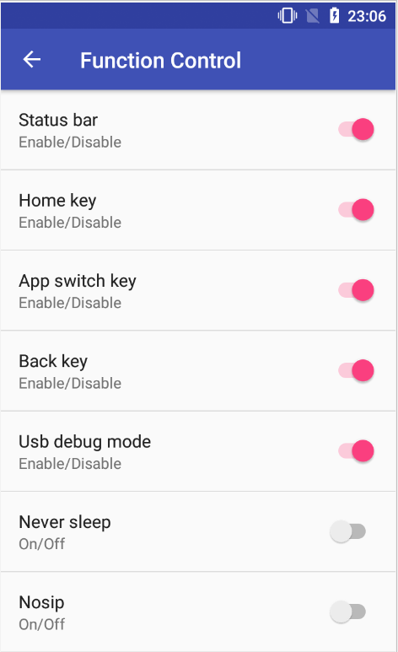
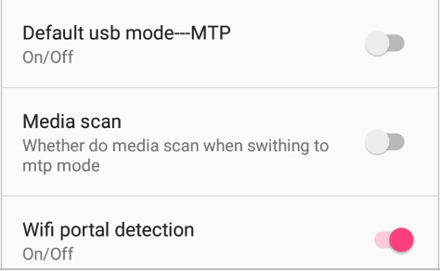
General settings
Function Control:
Status bar/Home key/App switch key/Back key/Usb debug mode/Never sleep:
Function as description.
Nosip:
Switch on---Hide current IME and disable IME
Switch off---OS default behavior
Default usb mode-MTP:
Switch off---Charging(OS default behavior)
Switch on---MTP(Media Transfer Protocol)
Media Scan: Situation:Sometimes PDA receive/create new files(Maybe by WeChat,WhatsApp,etc),we want to copy them to our PC,but when connect devices with PC,can’t find corresponding file in target direction.
This means file location was not updated in time.
Reason is that Media scan only happen after device reboot or a period of time.
Switch on---do media scan when switching to MTP mode
Switch off---OS default behavior
Wifi portal detection:
Once connect wifi,OS will try to access some Google web to check whether this wifi is available.Some countries have network firewalls that cannot access Google. May cause misunderstanding.
Switch on---OS default behavior
Switch off---Don’t do portal detection

Slide 8
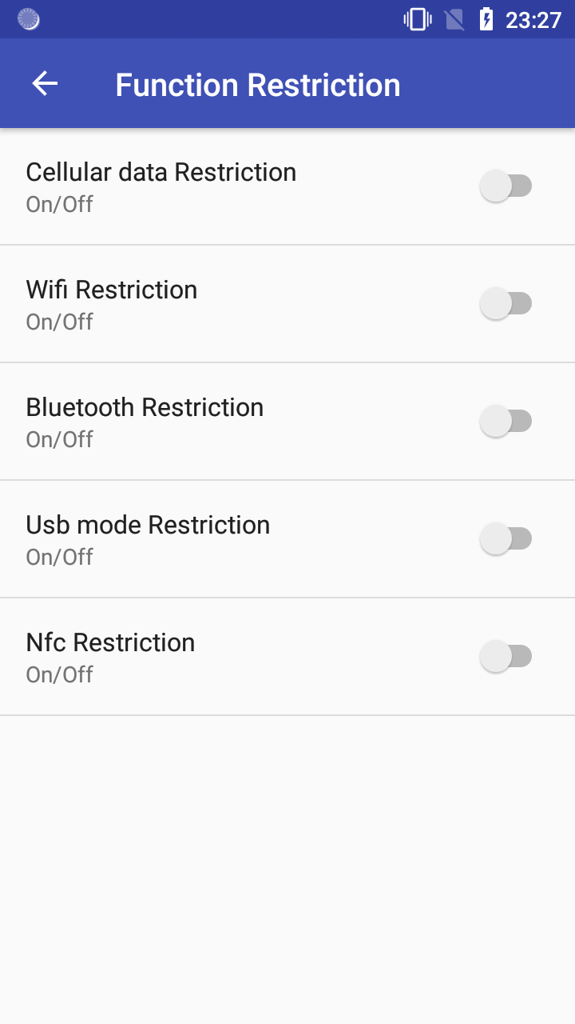
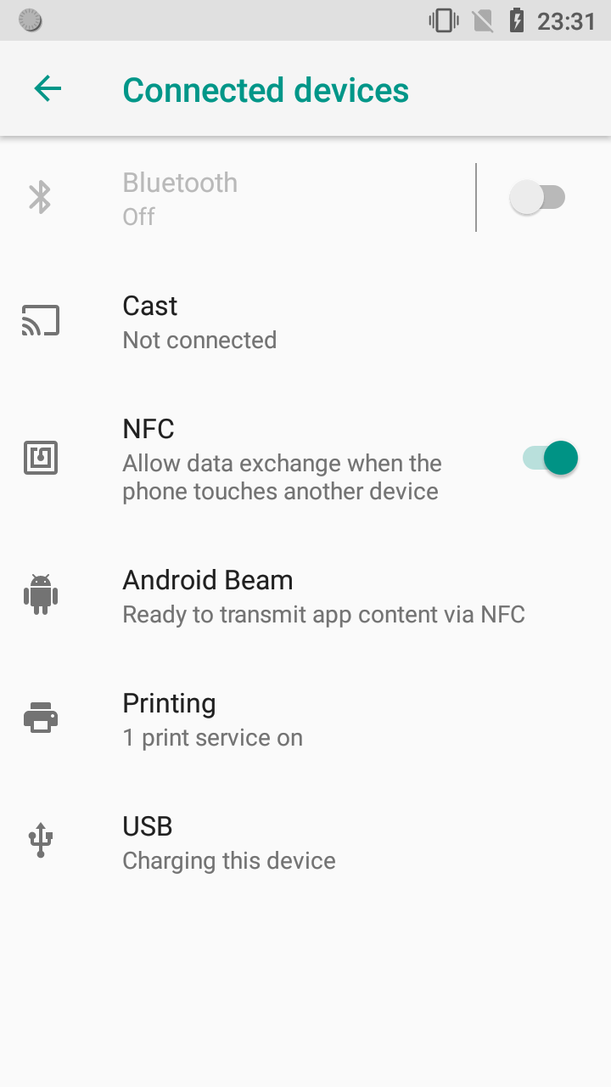
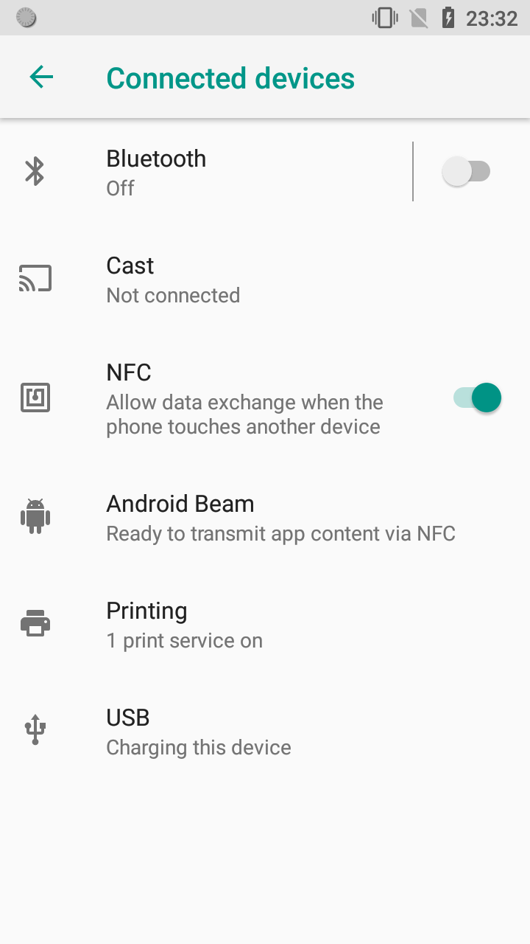
General settings
Function Restriction: Cellular data/Wifi/Bluetooth/Usb mode/Nfc Restriction:
Switch on---Disallow user to change them
Swtich off---OS default behavior
For example,when turn on/off Bluetooth Restrction:
Notes:Function restriction are achieved by calling Honeywell MDM interface.Some customers prefer to UI rather than DeviceConfig or MDM SDK way.

Slide 9
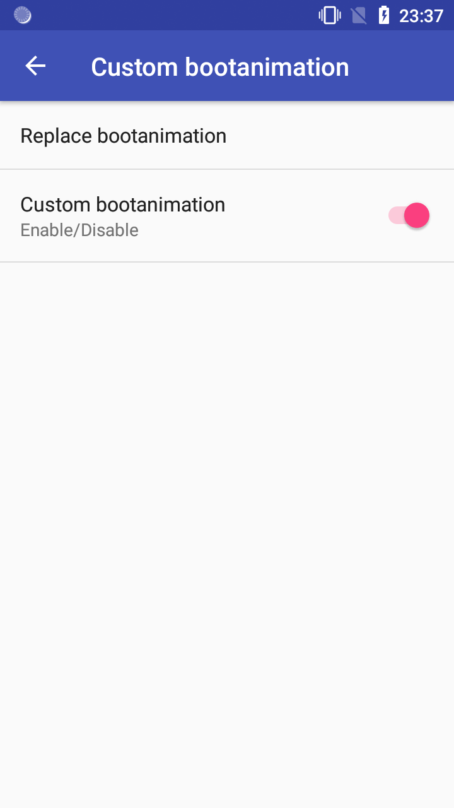
General settings
Custom bootanimation: Switch on---Use the bootanimation you choosed by clicking Replace bootanimation
Swtich off---OS default behavior(Use Honeywell Bootanimation)
Notes:
Make sure customers’ bootanimation file is renamed to bootanimation.zip.
Make sure the resolution of frames in bootanimtion.zip is the same as the device. Otherwise won’t take effect.

Slide 10
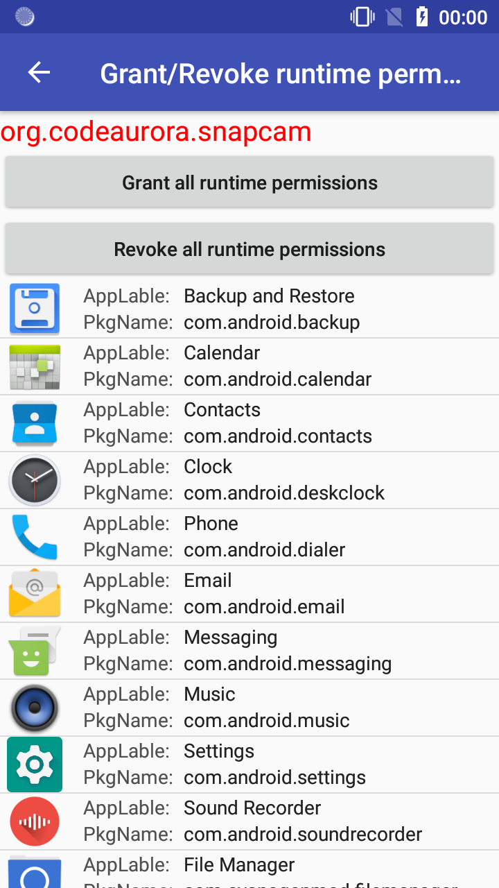
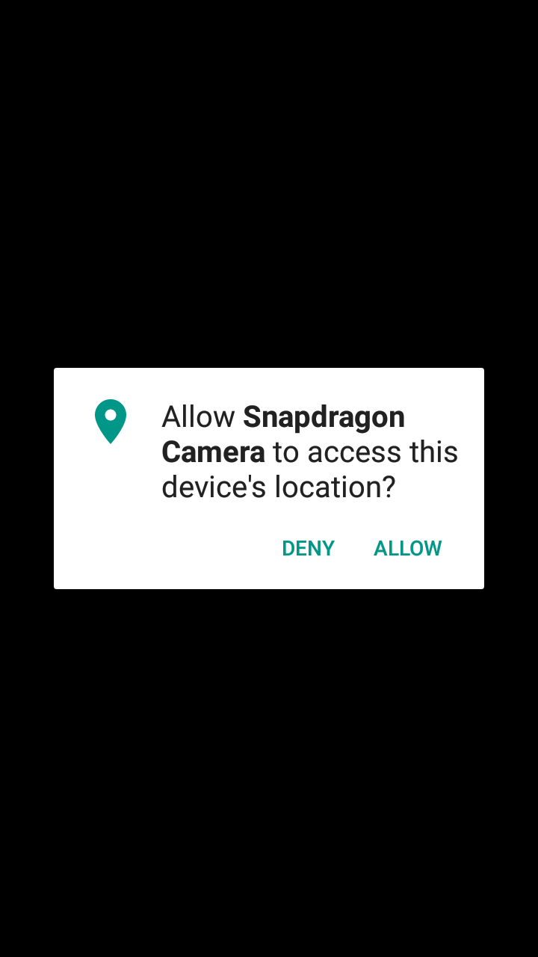
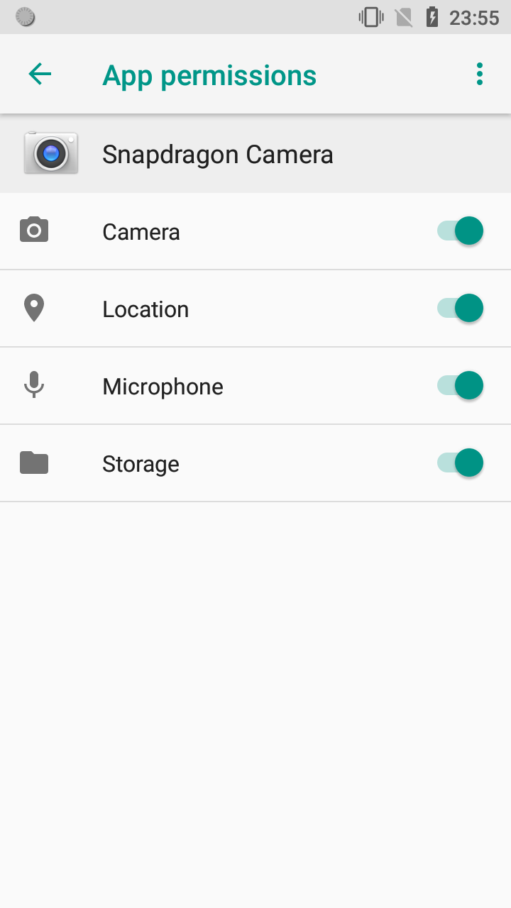
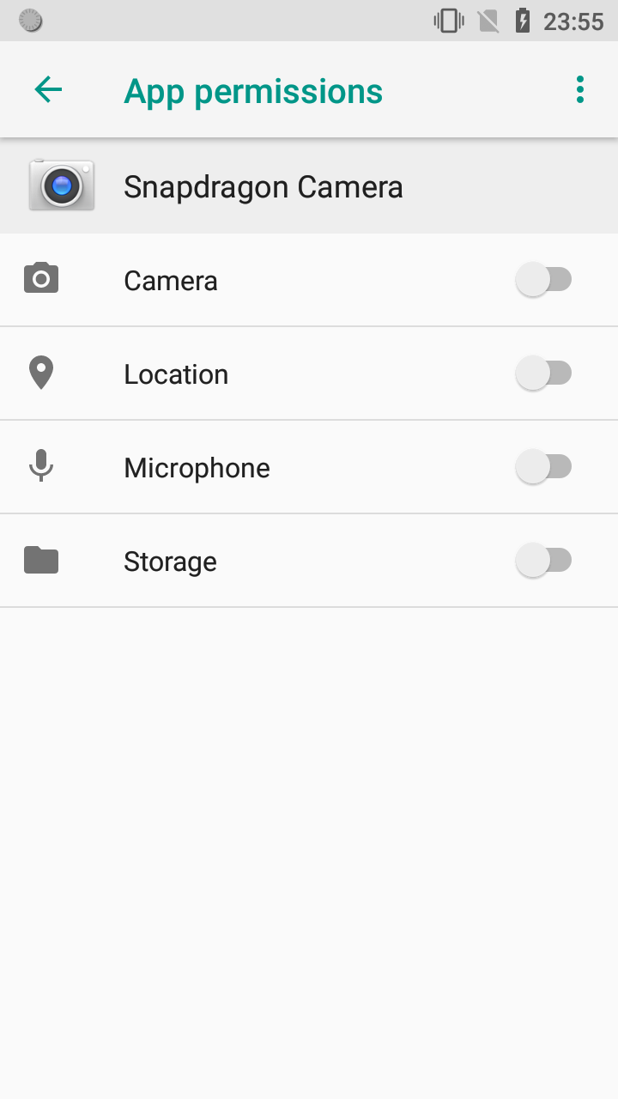
General settings
Grant/Revoke runtime permissions: Android used runtime permissions on OS version>= 6.0
This means if application(especially 3rd application) need request for allowing these dangerous runtime permission by popping up dialog.Just like Pic1.
Grant all---Allow all runtime permissions requested by the app,like Pic2
Revoke all---Remove all runtime permissions requested by the app,like Pic3
This means we can give application the runtime permission they applied for without the user’s perception. If use sdk way or broadcast way, will be more secret.
Pic1
Pic2
Pic3

Slide 11
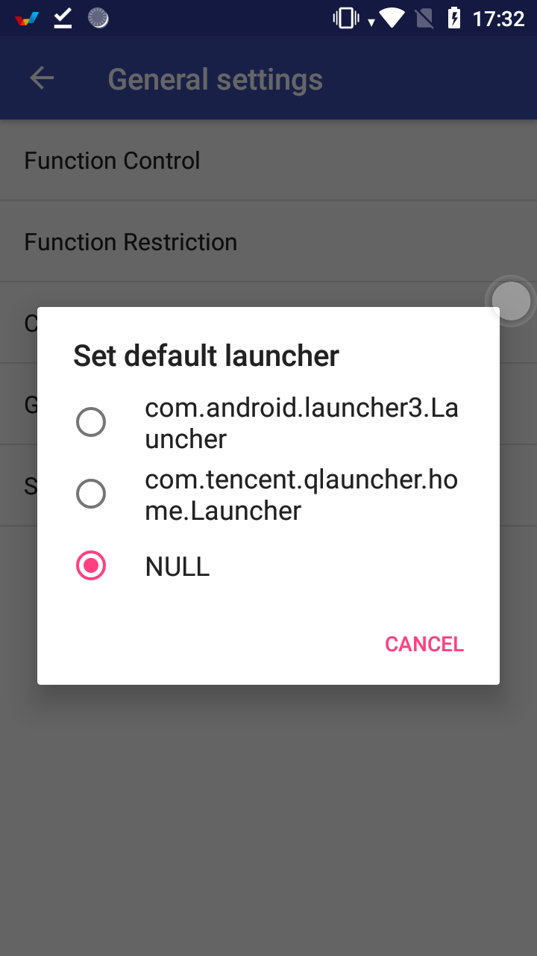
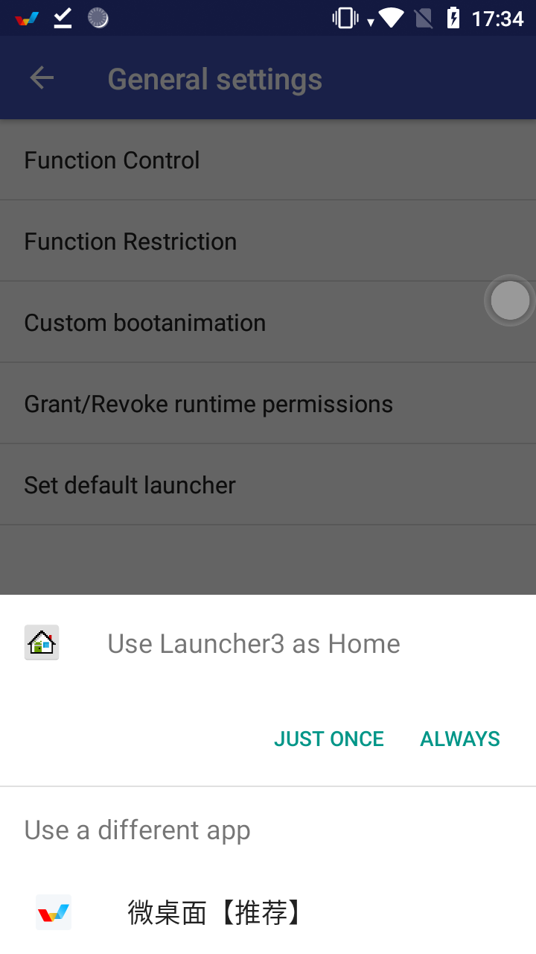
General settings
Set default launcher:
Assume our Device installed another Launcher application just now,then we press Home button,you will see pic1.Pop up a dialog advise customer to choose.
Null---OS default behavior
Launcher’s pkgName---Set default launcher you choosed.Will not pop up this dialog.
This means you can change default launcher without the user’s perception.(Especially if new launcher was installed by silent install.)
Pic1

Slide 12
Thanks for watching!

